Slide 1


Nicholas Nolet
Aug 27th 2022

Slide 2

Outline
Executive Summary
Introduction
Methodology
Results
Conclusion
Appendix

Slide 3
Executive Summary
Methodology
Data collected through API and web scraping
Data cleaning
EDA with SQL and Data visualization
Folium for interactive data visualisation
Machine learning Model building and prediction
Results
Exploratory Data analysis conducted
Predictive Analytics through Machine Learning

Slide 4
Introduction
Successful landing of Falcon 9 first stage is essential for Space X to predict the cost of the launch. Reuse of the first stage rocket allows Space X to launch for much more competitive prices.
This analysis aims to determine if predictive models can be created for the successful landing of the first stage

Slide 5

Section 1

Slide 6
Methodology
Executive Summary
Data collection methodology:
SpaceX Rest API
Wikipedia web scrapping with beautiful soup
Perform data wrangling
Data was imported in a pandas data frame, filtered and cleaned
Perform exploratory data analysis (EDA) using visualization and SQL
Perform interactive visual analytics using Folium and Plotly Dash
Perform predictive analysis using classification models
Logistic regression, Support Vector Machine, K nearest neighbor and Decision Trees evaluated for best prediction accuracy

Slide 7
Data Collection
Data was collected using the Space X API using the requests library. Data was store in a pandas data from and filtered for Falcon 9 stage 1 landings and missing values were replaced with means
Data was also collected using beautiful soup to scrap data from wikipedia
Web Scrapping
HTML response from Wikipedia
Extra data using beautiful soup
Normalize data into csv
SpaceX API
request library
Data filtered and missing values replaced with means
normalize json
Booster data
Launch site data
payload data
core data
SpaceX API
Pandas data frame
Cleaned Pandas data frame

Slide 8
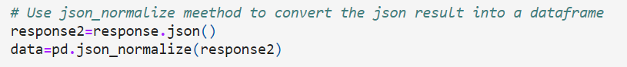
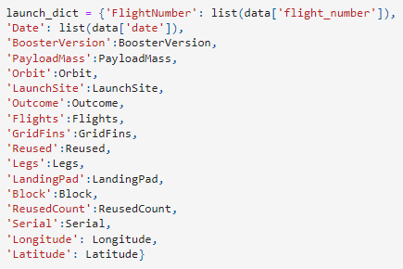
Data Collection – SpaceX API
Data is imported as json file
Data collection with SpaceX REST API
import data as json
convert to pandas dataframe
data is cleaned using custom function, assigned to a dictionairy then to a list
Data filtered for Falcon 9 rockets only
Missing values replaced with means
2. Data is converted in pandas data frame
4. Data assigned to dictionary then dataframe
3. Data is cleaned using functions
5. Data filtered for falcon 9 rockets only
6. Missing values replaced with means
https://github.com/nicnolet/ibmcapstone/blob/main/jupyter-labs-spacex-data-collection-api.ipynb

Slide 9
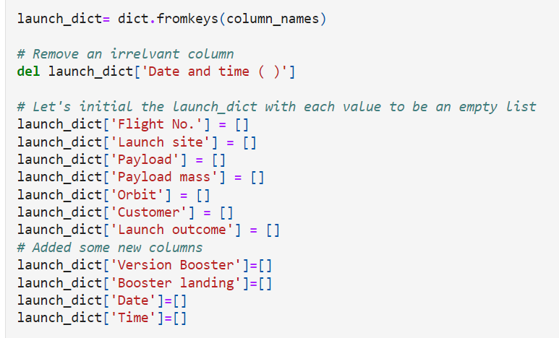
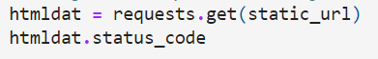
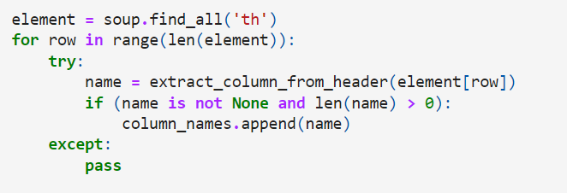
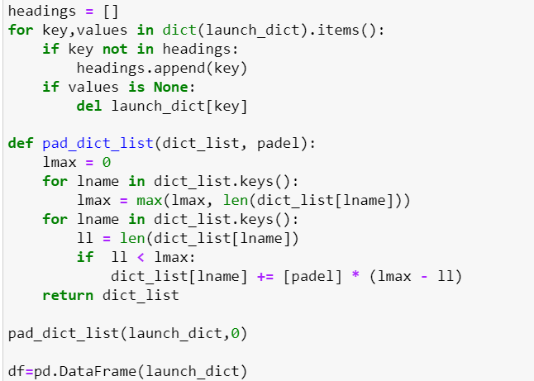
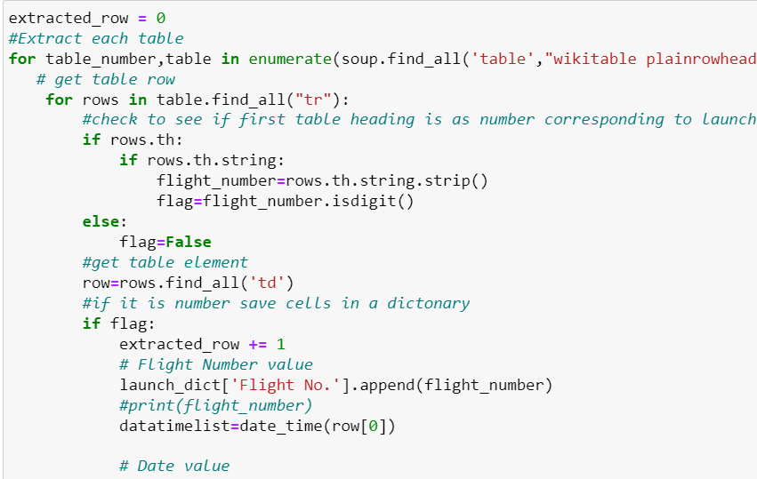
Data Collection - Scraping
5..Create empty dictionary with column names
Get HTTP resonse
Web scraping from Wikipedia
2. .Create beautiful soup object with HTTP response
3. .Put all tables into a soup object
https://github.com/nicnolet/ibmcapstone/blob/main/jupyter-labs-webscraping.ipynb
4. .Find all Column Names
7.Convert dictionary to dataframe
6.Fill launch dictionary with data

Slide 10
Data Wrangling
Exploratory Data Analysis and Data labelling
Number of Launch Sites calculated
Number and Occurence of each orbit calculated
Calculate the number and occurence of mission outcome per orbit type
Create a landing outcome label

Slide 11
EDA with Data Visualization
Scatterplots
Flight number by Payload
Flight number by Launch site
Payload by Launch site
Flight number by Orbit type
Payload and Orbit type
Barchart
Success vs orbit type
Lineplot
Success rate by year
https://github.com/nicnolet/ibmcapstone/blob/main/jupyter-labs-eda-datavizfin.ipynb

Slide 12
EDA with SQL
SQL queries conducted
Names of unique launch sites
Display 5 records where launch sites begin with the string 'CCA'
Display the total payload mass carried by boosters launched by NASA (CRS)
Display average payload mass carried by booster version F9 v1.1
List the date when the first succesful landing outcome in ground pad was acheived.
List the names of the boosters which have success in drone ship and have payload mass greater than 4000 but less than 6000
List the total number of successful and failure mission outcomes
List the names of the booster_versions which have carried the maximum payload mass.
List the records which will display the month names, failure landing_outcomes in drone ship ,booster versions, launch_site for the months in year 2015.
Rank the count of successful landing_outcomes between the date 04-06-2010 and 20-03-2017 in descending order.
https://github.com/nicnolet/ibmcapstone/blob/main/jupyter-labs-eda-sql-coursera_sqllite.ipynb

Slide 13
Build an Interactive Map with Folium
Objects add to Folium Map
all launch sites
Marker clusters of Success/failures at each launch site
distance from launch site to shore
https://github.com/nicnolet/ibmcapstone/blob/main/lab_jupyter_launch_site_location_fin.ipynb

Slide 14
Build a Dashboard with Plotly Dash
Plots
Total success by all sites: view the most successful launch site
Success rate by each site: view the launch success of individual sites
Success by payload mass with slider to view different payload masses: allows to view success rate by different payload mass
https://github.com/nicnolet/ibmcapstone/blob/main/spacex_dash_appfin.py

Slide 15
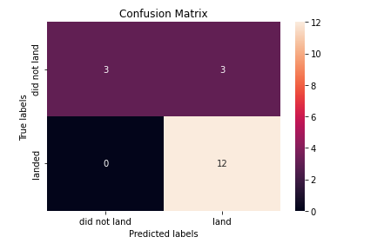
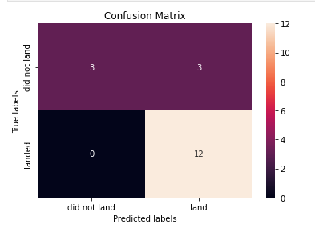
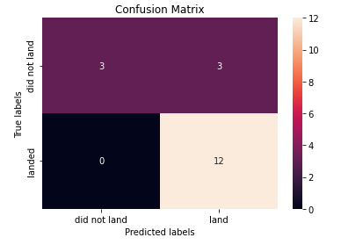
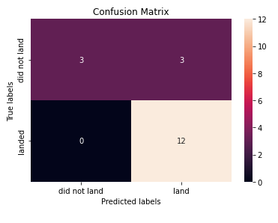
Predictive Analysis (Classification)
Data split into test and train set
logistic regression, KNN, SVM, and decision tree models all had an accuracy of .80 or better
Logistic Regression
SVM
Decision Tree
KNN
https://github.com/nicnolet/ibmcapstone/blob/main/SpaceX_Machine%20Learning%20Prediction_Part_5%20fin.ipynb

Slide 16
Results
Exploratory data analysis reveal low weight payloads performed best
SpaceX launches have been improving in success with each year
All Classification Models- LR, SVM, KNN and decision trees performed similarly

Slide 17

Section 2

Slide 18
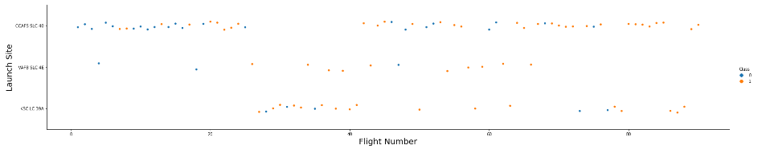
Flight Number vs. Launch Site
Most Launches are from CCAFS SLC 40
Sucess of launch increases with number of flights

Slide 19
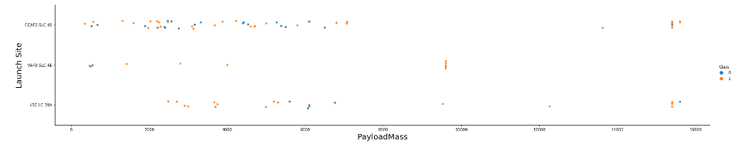
Payload vs. Launch Site
Mostly low weight payloads are launched from CCAFS SLC 40
No rockets with heavy payload launched from VAFB-SLC

Slide 20
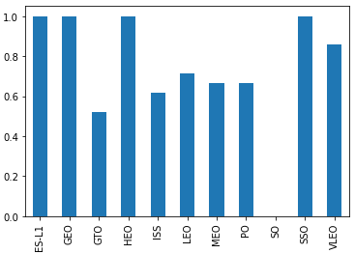
Success Rate vs. Orbit Type
Success
Orbits of ES-L1, GEO, HEO and SSO had the best success rate
Orbit

Slide 21
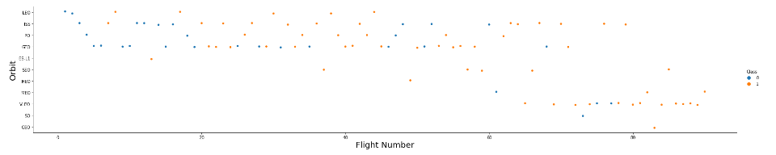
Flight Number vs. Orbit Type
VLEO orbits have become the most common launches

Slide 22
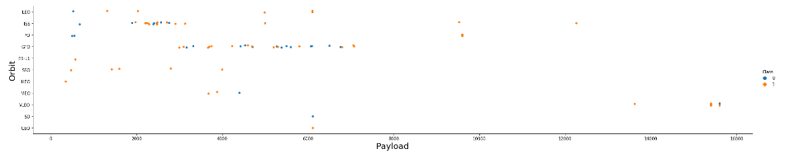
Payload vs. Orbit Type
Certain orbits tend to have specific payloads
GTO orbits have payloads between 4000 - 8000
ISS orbits are between 2000-400
VLEO orbits tend to be the heaviest around 14000 - 16000

Slide 23
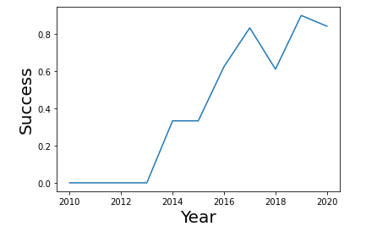
Launch Success Yearly Trend
Success of launches increases by year

Slide 24
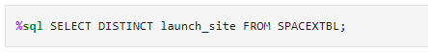
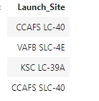
All Launch Site Names

Slide 25
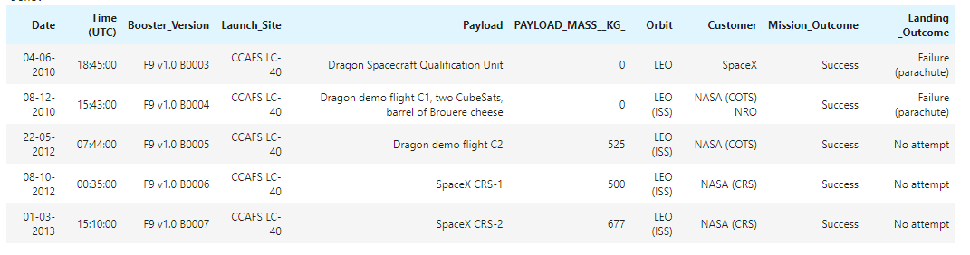
Launch Site Names Begin with 'CCA'

Slide 26
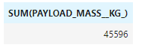
Total Payload Mass

Slide 27
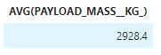
Average Payload Mass by F9 v1.1

Slide 28
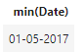
First Successful Ground Landing Date

Slide 29
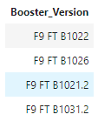
Successful Drone Ship Landing with Payload between 4000 and 6000

Slide 30
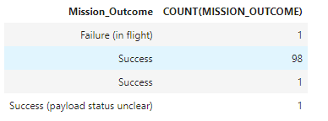
Total Number of Successful and Failure Mission Outcomes

Slide 31
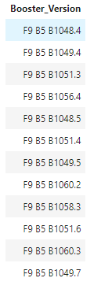
Boosters Carried Maximum Payload

Slide 32
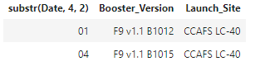
2015 Launch Records

Slide 33
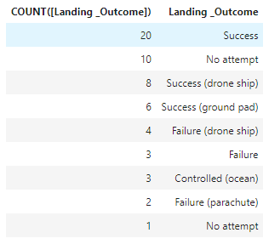
Rank Landing Outcomes Between 2010-06-04 and 2017-03-20

Slide 34

Section 3

Slide 35
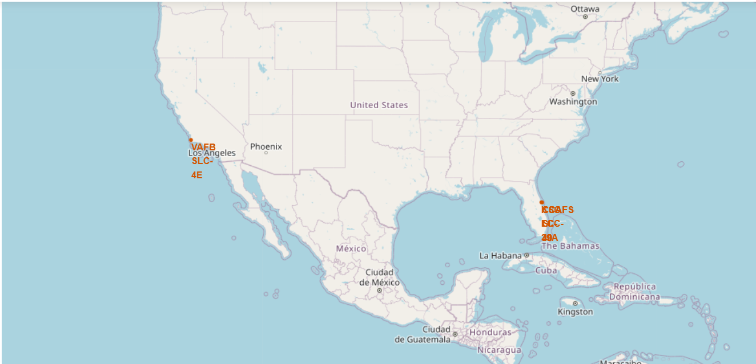
Folium Map of All Launch Sites
Folium map showing locations of all launch sites

Slide 36
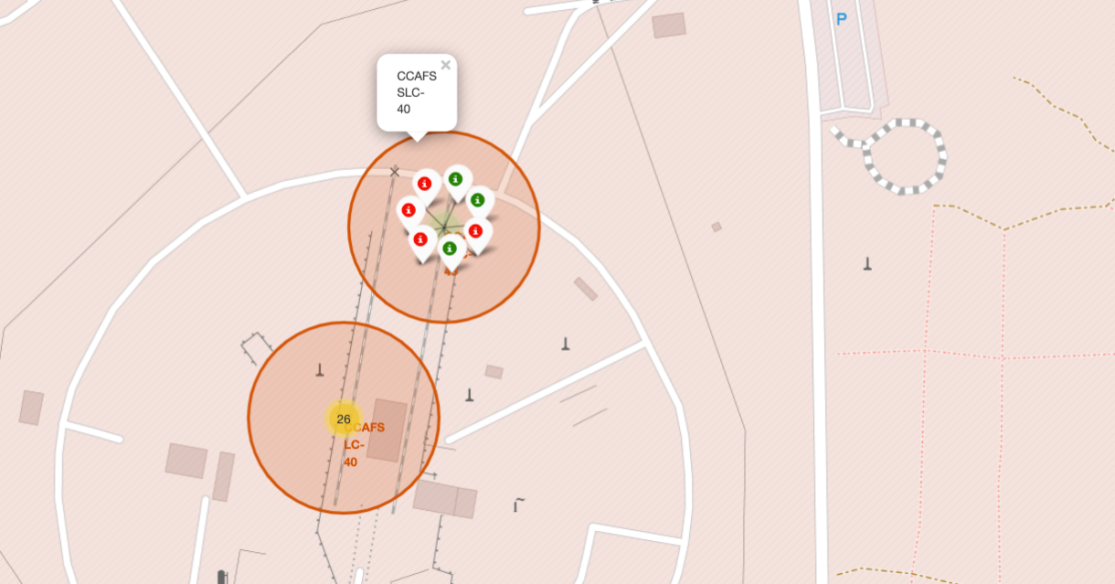
Folium map with success/fail marker
Markers indicate if launch was successful or a failure

Slide 37
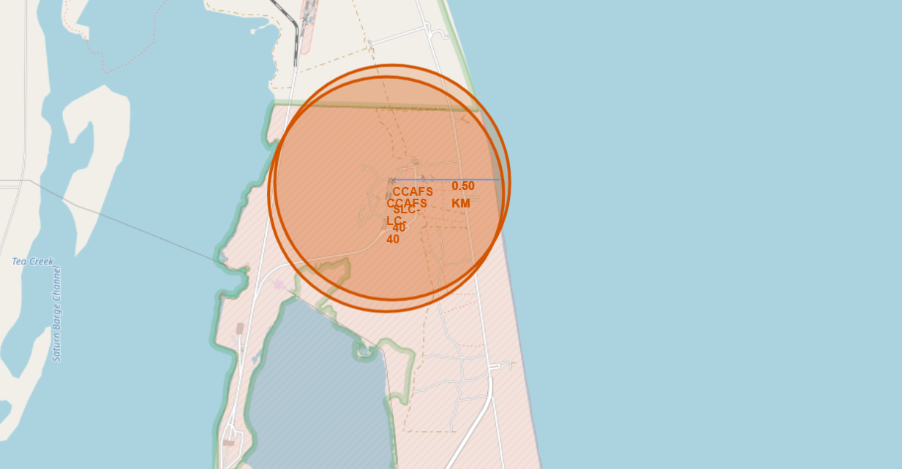
Folium Map with Distance to Object
Folium map showing distance from launch site to coast

Slide 38

Section 4

Slide 39
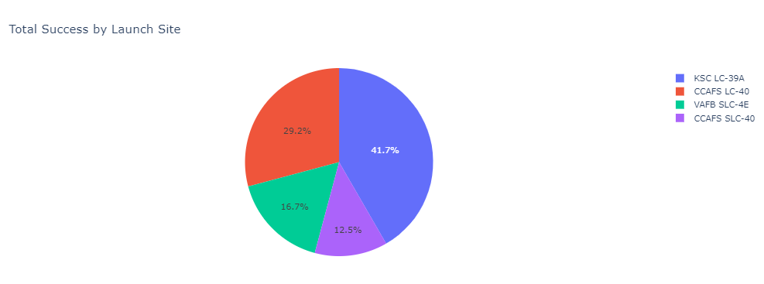
Success Rate by Launch Site
KSC LC-39A had the most successful launches

Slide 40
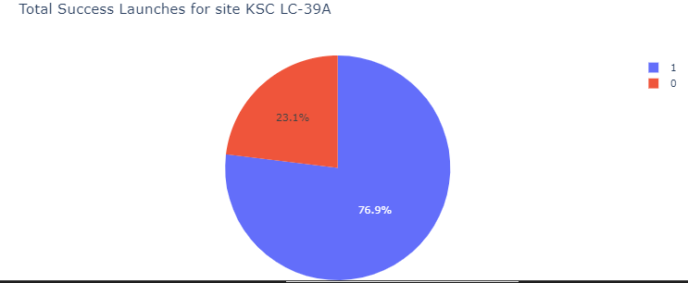
Success Rate of KSC LC-39A launchsite
KSC LC-39A had a 76.9 launch success rate

Slide 41
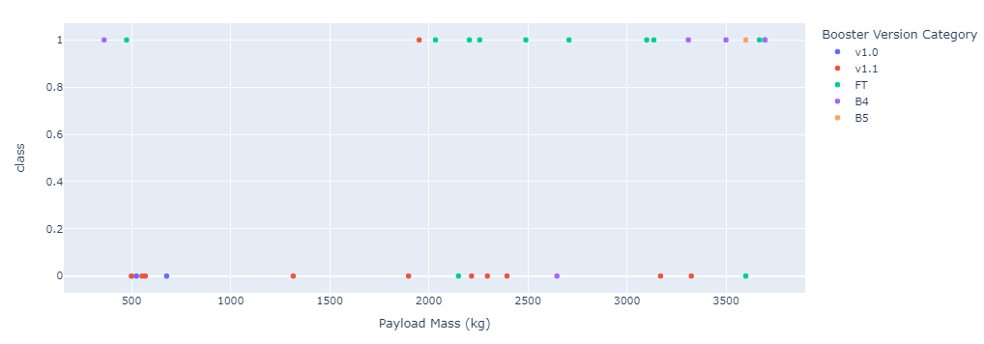
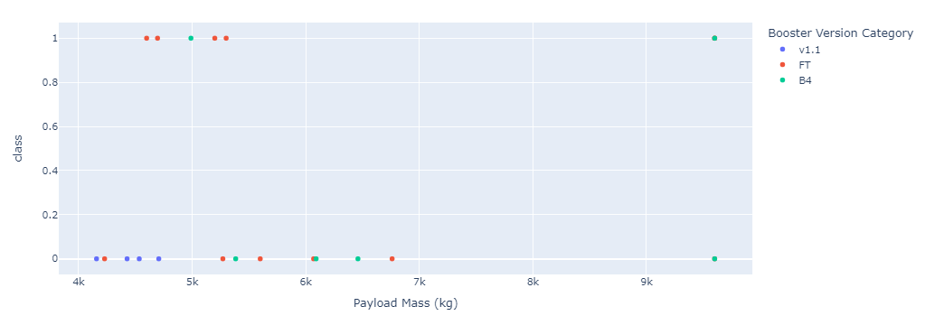
Success rate by Payload Mass
Success rate is higher when the payload mass is under 4000kg

Slide 42

Section 5

Slide 43
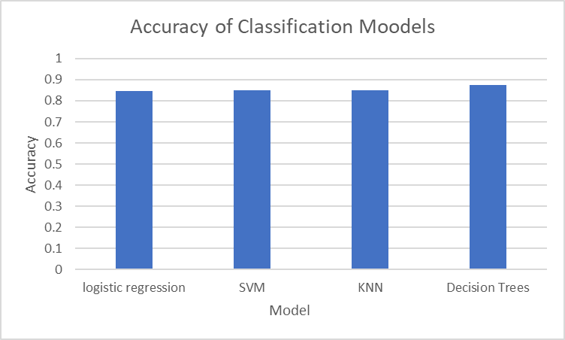
Classification Accuracy
All models had similar accuracy

Slide 44

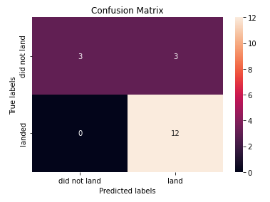
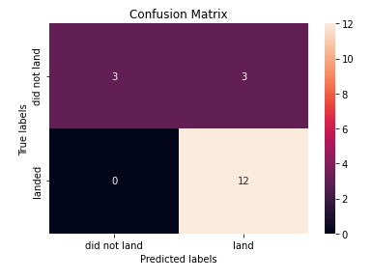
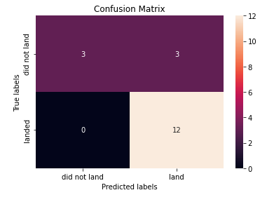
Confusion Matrix
Logistic Regression
SVM
Decision Tree
KNN

Slide 45
Conclusions
All models perform similarly for predicting accuracy of launch success
Low payload weights have higher success than heavier payloads
Success rate increases with time
KSC LC 39A is the most successful launch sites

Slide 46


